Slide 1




“THE INFLUENCE OF NEWS SENTIMENTS ON STOCK PRICE PREDICTION: A MACHINE LEARNING APPROACH
Submitted By:
Name: Kuldeep Singh Prajapati
Enrollment No: 05119011621
University School of Automation & Robotics , GGSIPU EDC, Surajmal Vihar
Supervised By:
Dr. Anshul Bhatia
Assistant Professor, USAR
Next Page

Slide 2


Introduction
Overview:
This project explores how financial news sentiment impacts short-term stock price movements of American-listed companies.
Combines historical stock data with sentiment scores from top news summary.
Uses Natural Language Processing (NLP) and machine learning to create hybrid forecasting models.
Approach:
Gathered data from Yahoo Finance & Finnhub API.
Used VADER for sentiment scoring and technical indicators like:
MACD
RSI
Bollinger Bands
Applied & compared models:
1 ML Models: Random Forest, XGBoost
2 Time Series Models: AR, ARIMA, SARIMA
Key Objectives:
🧠 Assess impact of news sentiment on stock prices.
📈 Predict stock prices for the next 5 days.
💹 Provide daily trading recommendations.
Next Page

Slide 3


Motivation
1
I’ve always been fascinated by financial markets and AI. The idea of using NLP to interpret financial news and integrate it with machine learning and time series forecasting felt like a powerful application of what I’ve studied. Also, it has real-world relevance in algorithmic trading and investment decision-making.
2
In a world where a tweet can crash markets faster than a recession, we wondered — can headlines hold the secret to smarter stock predictions? This project combines the buzz of the news with the brains of machine learning to find out.
Next Page

Slide 4


Problem Statement
Stock price prediction is challenging due to market volatility, especially for mid- and small-cap companies where sentiment plays a major role. Traditional models often overlook real-time news sentiment and technical indicators. This project investigates whether combining sentiment analysis, historical data, and technical indicators can improve short-term stock forecasts and generate actionable trading signals.
Next Page

Slide 5



Data Sources
News Sentiment Data
Obtain via Finnhub API and analyzed using VADER and TextBlob sentiment analysis tools.
Historical Stock Data
Collected from Yahoo Finance, providing past stock prices and trends.
Technical Indicators
RSI (Relative Strength Index)
MACD (Moving Average Convergence Divergence)
BB (Bollinger Bands)
Next Page

Slide 6
Methodology
1. Project Flow Overview
Data Collection:
Historical stock data from Yahoo Finance
News headlines via Finnhub API
Preprocessing:
Cleaned and merged datasets
Calculated technical indicators (MA, RSI, MACD, Bollinger Bands)
News sentiment analysis using VADER and TextBlob
2. Modeling & Prediction
Machine Learning Models:
Random Forest, XGBoost (for price prediction)
Time Series Models:
ARIMA, SARIMA (for trend forecasting)
Simulation Setup:
Train-test split (80:20)
Hyperparameter tuning using GridSearchCV
Backtesting in a simulated trading environment
3. Final Output
Integrated prediction + sentiment scores
Trading recommendations: Buy / Sell / Hold
Next Page

Slide 7

Sentiment Analysis Approach
1
VADER
2
TextBlob
used to capture the sentiment intensity of financial news, leveraging its strength in analyzing short-form text with emotional cues relevant to market reactions."
a general sentiment polarity score for news headlines, offering a complementary perspective to VADER and aiding in assessing the overall positive or negative leaning of market news.
Next Page

Slide 8

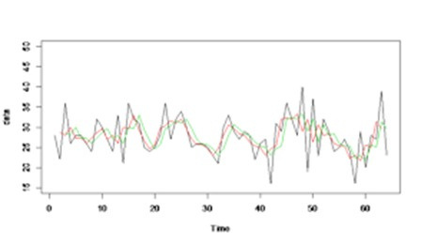
ML & Time Series Models Used
ML Based
Time Series Based
Random Forest
XGBoost)
AR
ARIMA
SARIMA
Next Page

Slide 9

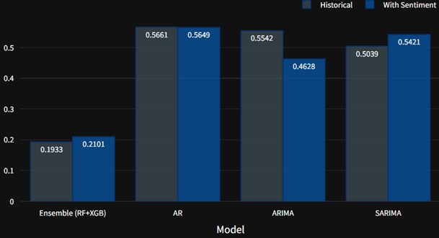
Simulation Environment & Result
Simulation Environment
Dashboard enforce visualizes
predictions and recommendations.
Logic generates Buy/Sell/Hold signals
based on predicted prices, simulating realistic market conditions.
Results and Evaluations
Models incorporating news sentiment showed comparison of MAE and RMSE against historical data-only models. Performance graphs highlight accuracy differences under both scenarios.
Next Page

Slide 10
Conclusion
Findings:-
Historical data remains most impactful for short-term forecasting.
Sentiment data adds marginal improvement, especially when news is impactful.
Ensemble models like XGBoost outperformed traditional ones in terms of accuracy.
Buy/Sell/Hold recommendations based on sentiment, MACD, and RSI showed promising alignment with trends.
Next Page

Slide 11
Future Scope
Advanced NLP: Use transformer models like FinBERT/LLMs for deeper sentiment analysis.
Real-time Data: Integrate streaming news and minute-level stock data for timely signals.
Multi-modal Learning: Combine textual, numerical, social media & macroeconomic data.
Next Page

Slide 12
If you have any question , you may ask.
Next Page

Slide 13


Thank You
For your time , Sir/Mam
(Have a nice day)
r

